Slide 1
Machine Learning & Deep Learning Approaches to Predict Students’ Attitudes from RateMyProfessors Reviews
Yuanxin Zhang & Yumeng Chen
Machine Learning Final Project

Slide 2

Agenda
Motivation
Dataset
Methodology and Implementation
Models
Discussions & Future Work
Conclusions

Slide 3

Motivation
→ Train appropriate machine learning models for predicting students' attitudes from comments, user and course features

Slide 4
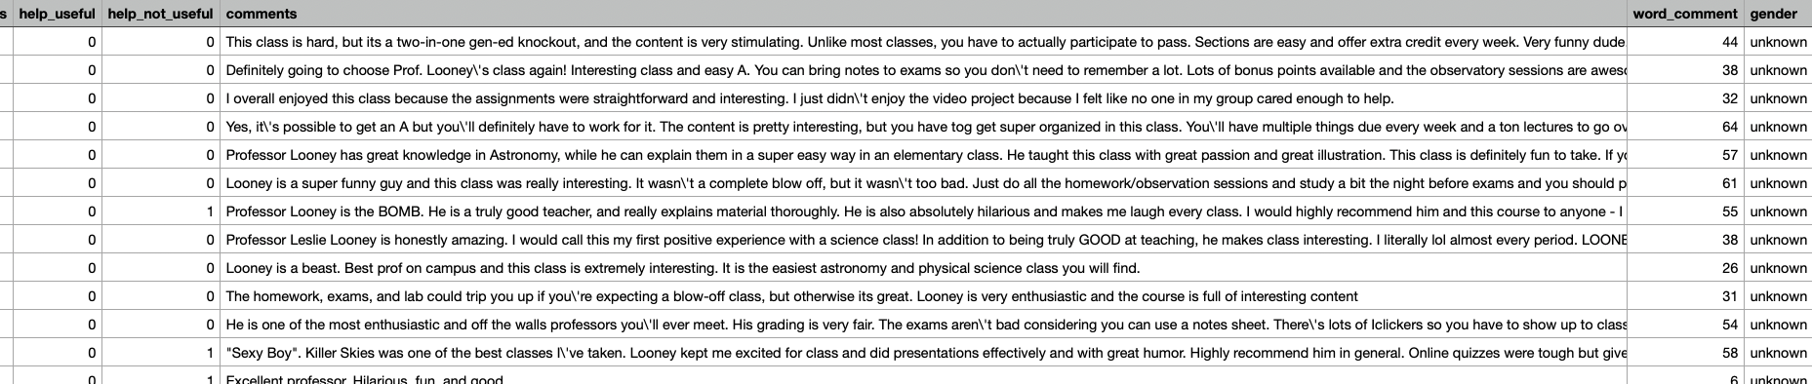
Dataset
Column name: professor name, school name, department name, local name, state name, num student, student star, student difficult, attendance, grades, comments…… 55 features, 20000+ comments in total
What we choose: department name, state name,num student, attitude(label), student difficult,word comment, and comments

Slide 5
Methodology and Implementation
Preprocessing( For entire comments):
Convert all comments into lowercase. (notice that the function lowercase() could not recognize numbers.)
Replace all dots with space.
Strip space and quotes(” and ’)at the end of each comment
Replace two or more spaces with one single space.
Replace all URLs with the word ”URL”. (The regular expression used to match URLs is www˙[§]+)—(https?://[§]+))
Replace all hashtags with the words with the hash symbol. (For instance, #perfect becomes perfect. The regular expression used to match hashtags is #(§+))

Slide 6
Methodology and Implementation
Preprocessing( For every word in each comment):
Remove all the punctuation [’”?!,.():;] from words
Convert more than two letter repetitions to 2 letters. (For instance, some students might write comments like She’s soooooo gooooood to strengthen their attitude. To continue the word-embedding part afterward, we transform this kind of comment into She’s so good.
Remove - and ’. Some words might have these signs as part of the words, for instance, t-shirt, there’s, etc. We convert them into tshirt and theres to help the ensuing process.

Slide 7
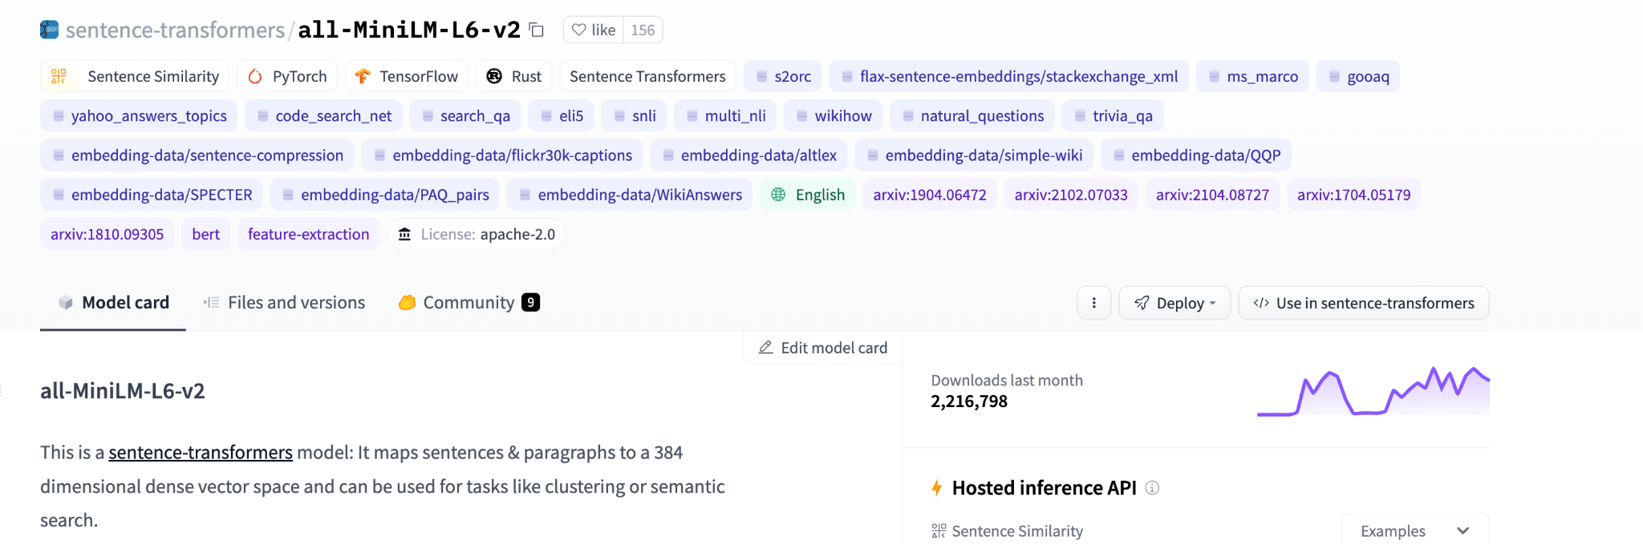
Methodology and Implementation
Word-Embedding:
Two principles: 1) Every word in one sentence should have a relation, which means every word is not an individual number, but in correlation with the previous and ensuing words or sentences. 2) Since we regard one comment as one input, therefore, regardless of the length of the comment, we should transform them into a uniform-length vector.
Sentence Transformer: all-MiniLM-L6- v2 model from Hugging Face

Slide 8
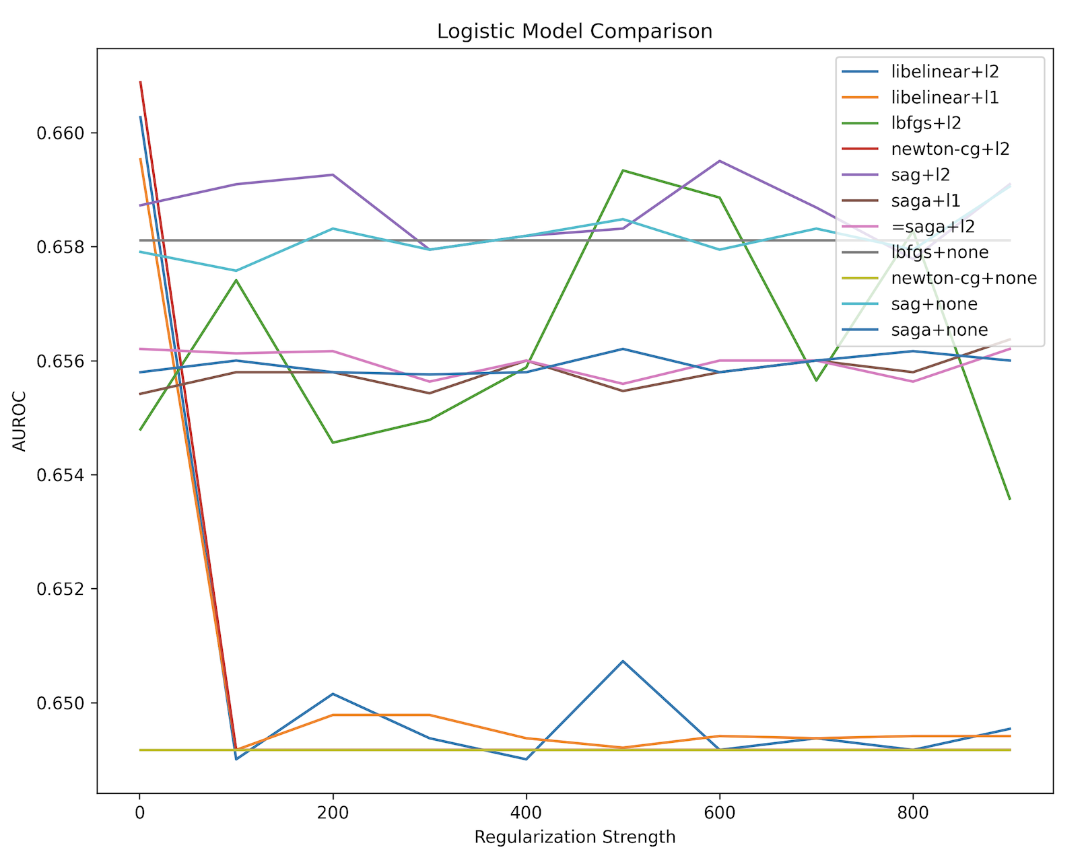
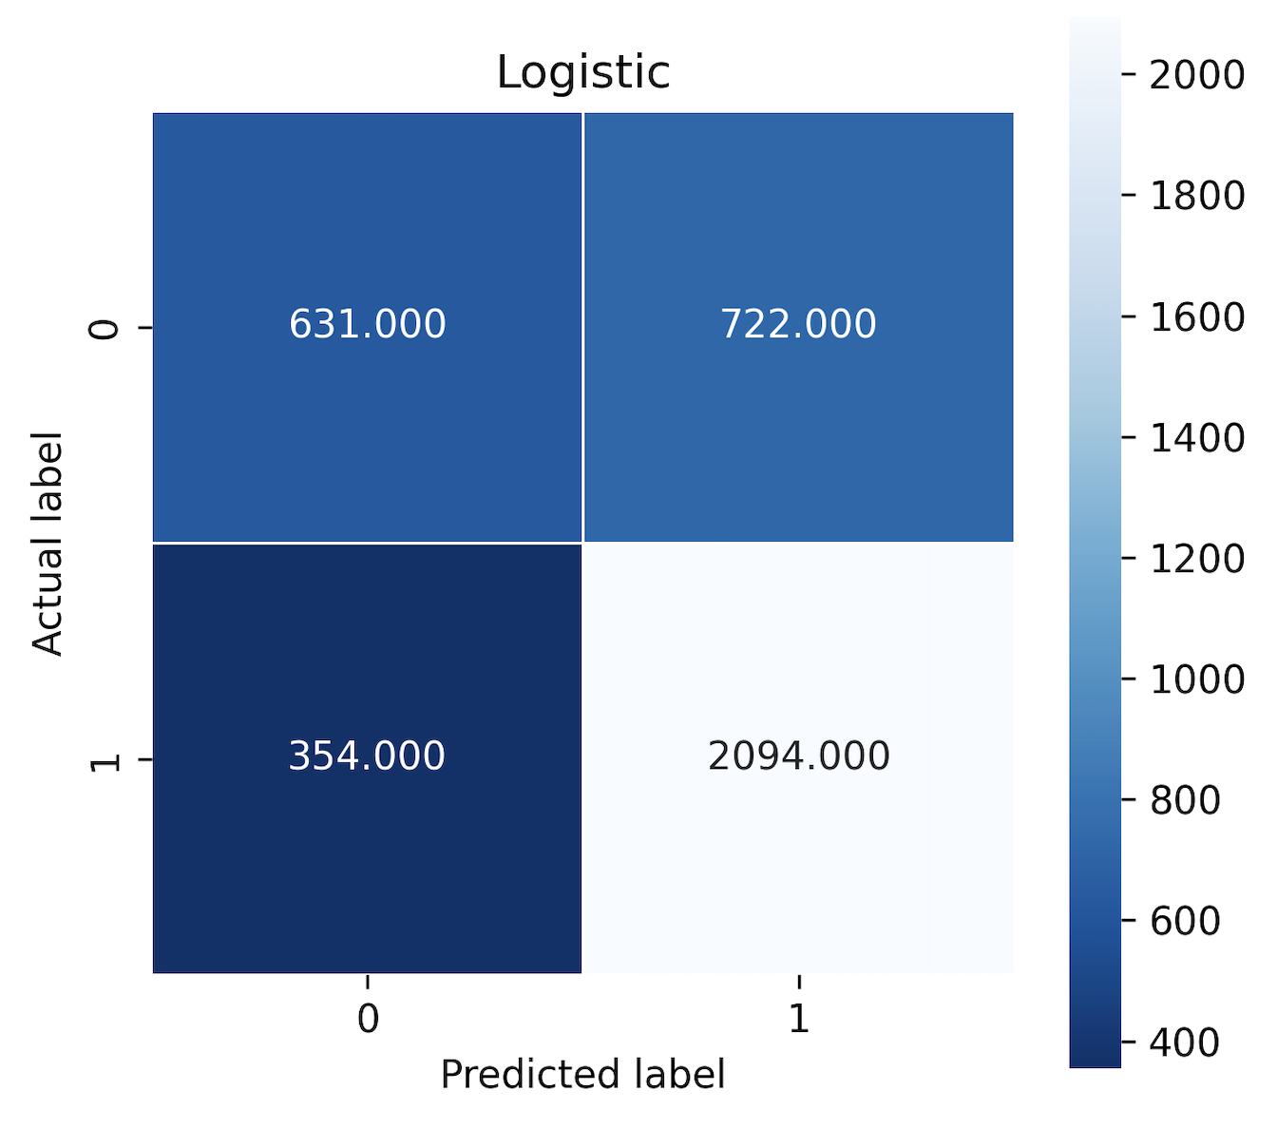
Models - Logistic Regression
Reason: binary outcomes
Hyperparameters tuned: solver, penalty, regularization strength
→ Best performance: AUROC=0.661, accuracy=74.4%

Slide 9
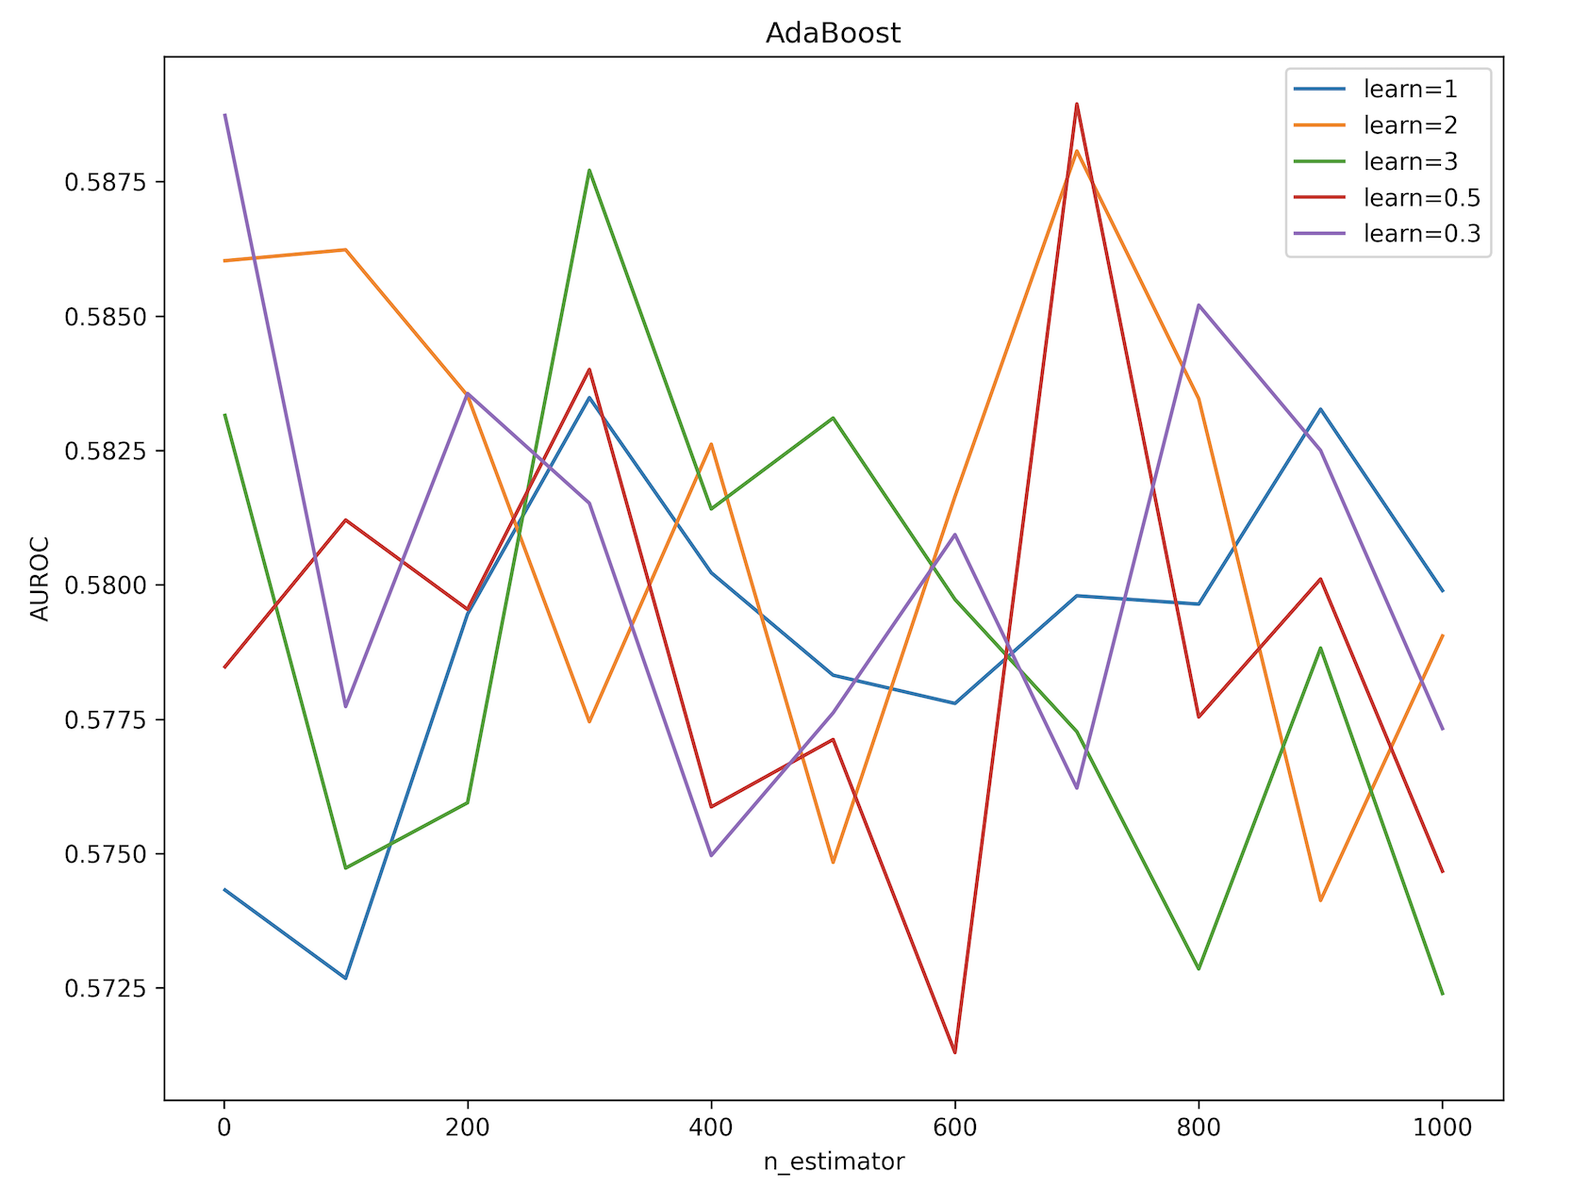
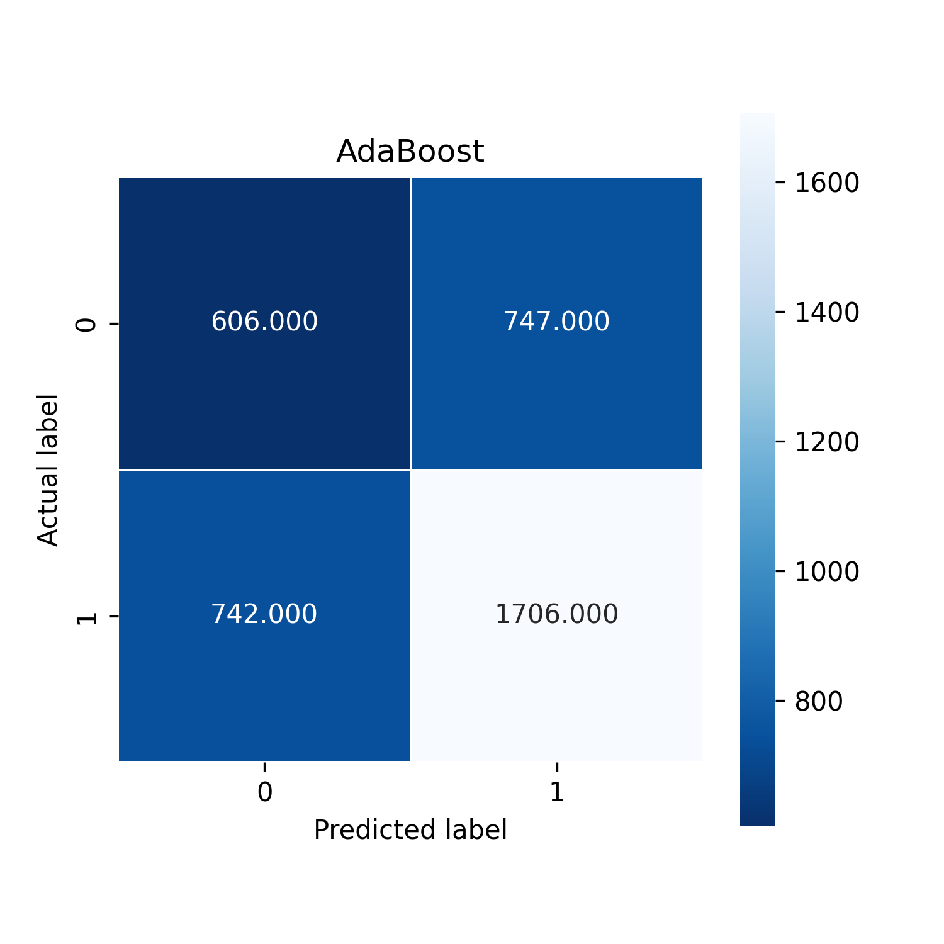
Models - AdaBoost
Reason: sequentially generating decision trees and learning from previous models. Punishing incorrectly predicted sample data by assigning higher weights
Hyperparameters tuned: learning rate, n_estimator
→ Best performance: AUROC=0.589, accuracy=70.0%

Slide 10
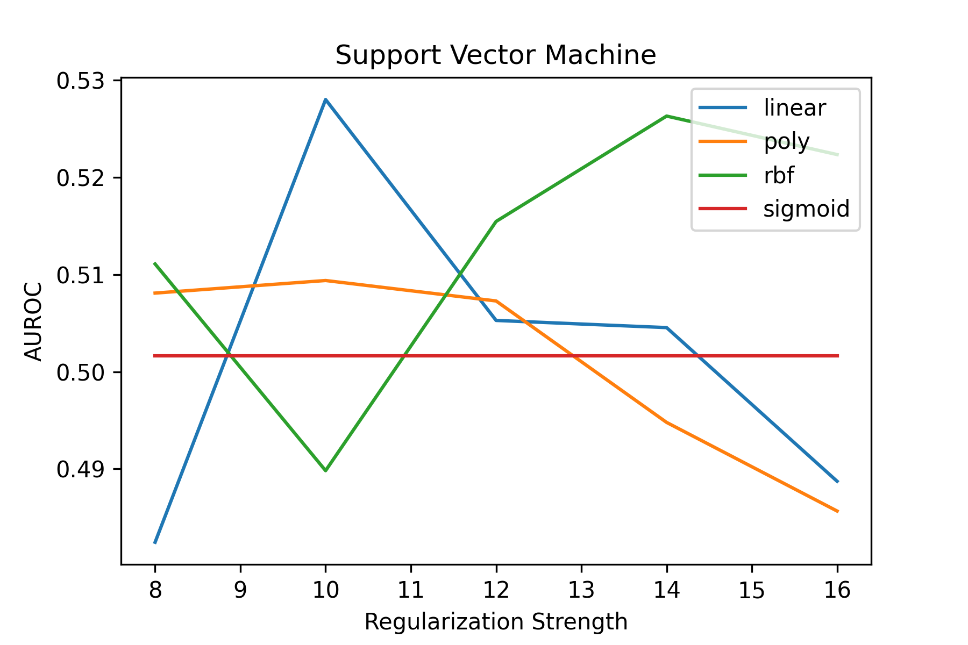
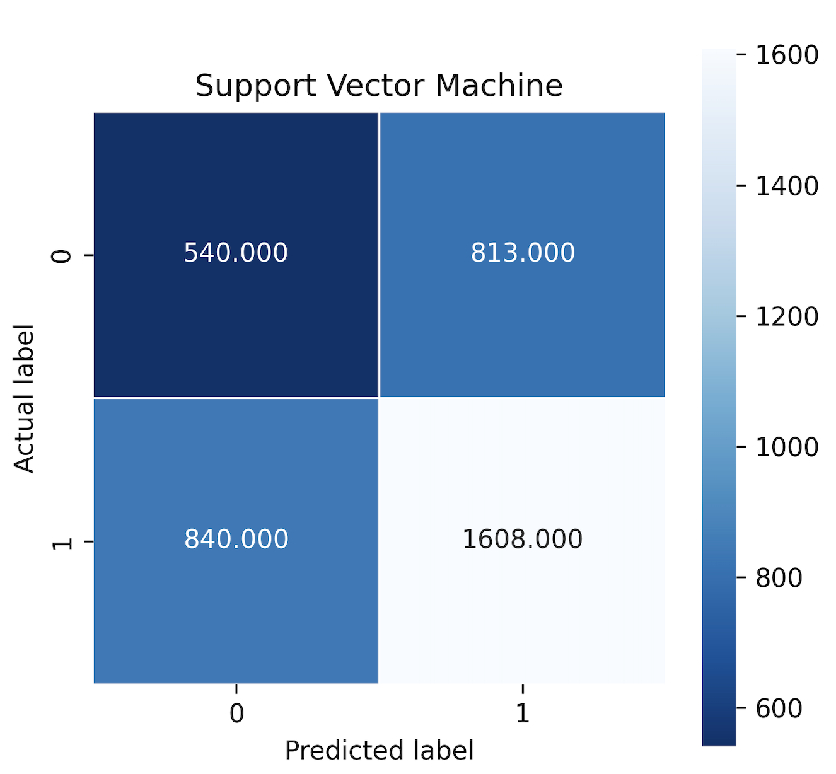
Models - SVM
Reason: maximizes the margin between ‘positive’ and ‘negative’, nonlinear classification by applying kernel
Hyperparameters tuned: kernel, regularization strength
→ Best performance: AUROC=0.528, accuracy=66.4%

Slide 11
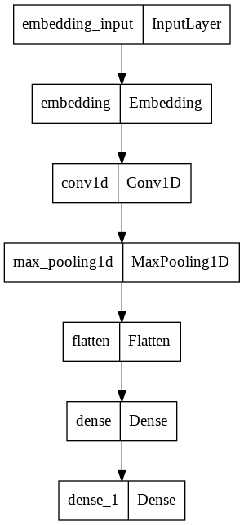
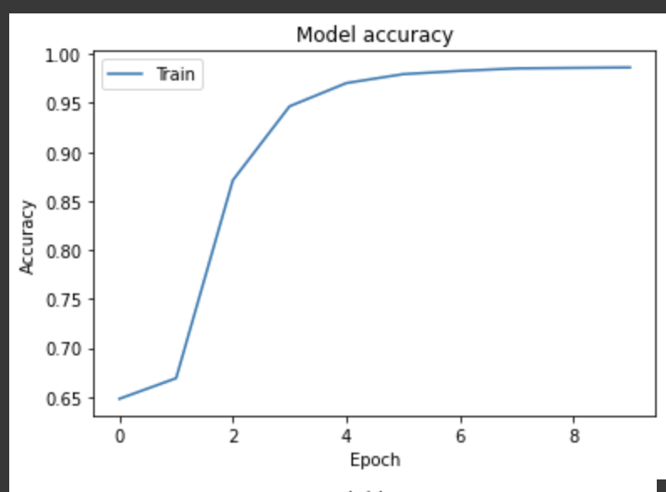
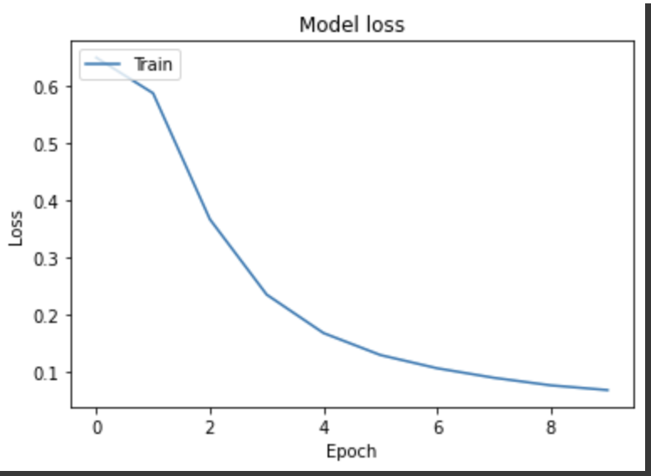
Models - Convolutional Neural Network
Reason: Simulate the entire Sentiment Analysis Process, from raw data texts to the final neural network training and performance
Hyperparameters tuned: learning rate, epochs, etc.
→ Best performance: accuracy=60.6%

Slide 12
Models Overview
 | Logistic | AdaBoost | SVM | CNN
AUROC | 0.661 | 0.589 | 0.528 | /
Accuracy | 74.4% | 70.0% | 66.4% | 60%
→ Best performance: logistic

Slide 13
Discussion & Conclusion
Discussion
Logistic gives the best performance (AUROC=0.661, accuracy=74.4%)
Potential Improvement
Improve tuning, try more hyper-parameters / PCA to reduce dimensionality
Tune hyperparameters for CNN
Divide attitudes into more categories, maybe 3
Conv1D, Conv2D, Conv3D
Try more models, e.g. LSTM / combine LSTM with CNN to avoid gradient vanishing or exploding

Slide 14
Thank you!
If you have any questions, feel free to contact Yuanxin Zhang (yz6201@nyu.edu) or Yumeng Chen (yc4144@nyu.edu).

